Slide 1
House Price Prediction
GitHub link :
https://github.com/Meg-Megnath/ML-Capstone-Project
Machine Learning project by :–
Megnath

Slide 2
Project Detail
Project Introduction:
House sale price prediction is a regression based supervised learning dataset.
The dataset is taken from Imarticus LMS portal.
The dependent variable here is Sale_Price.
There are 80 independent variable in the dataset.
Problem Statement:
Use Regression models to predict the price of a property.
Project Outcome :
Prediction of dependent variable using independent variables

Slide 3
Project Insights
Data Importation
Data Exploration
Data Cleaning
Data Transformation
Models Building
Evaluation of Models
Selection of Model
Fine Tuning the Model

Slide 4
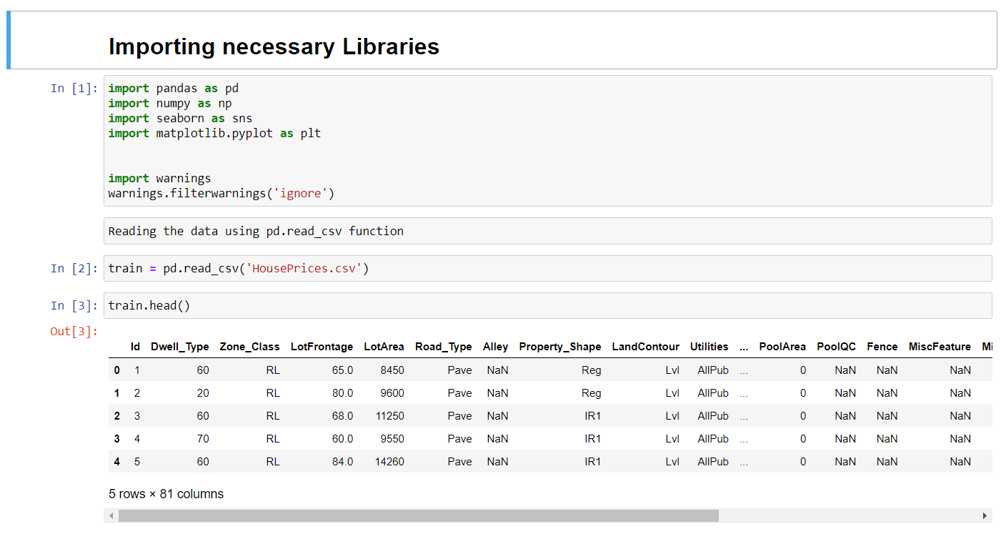
Data Importation
Step one any model building process is data importation. Data Import lets you upload data from external sources and combine it with data you collect via Analytics.
Pandas library is used to import data using pd.read_csv(). It is basically used for data manipulation and analysis.

Slide 5
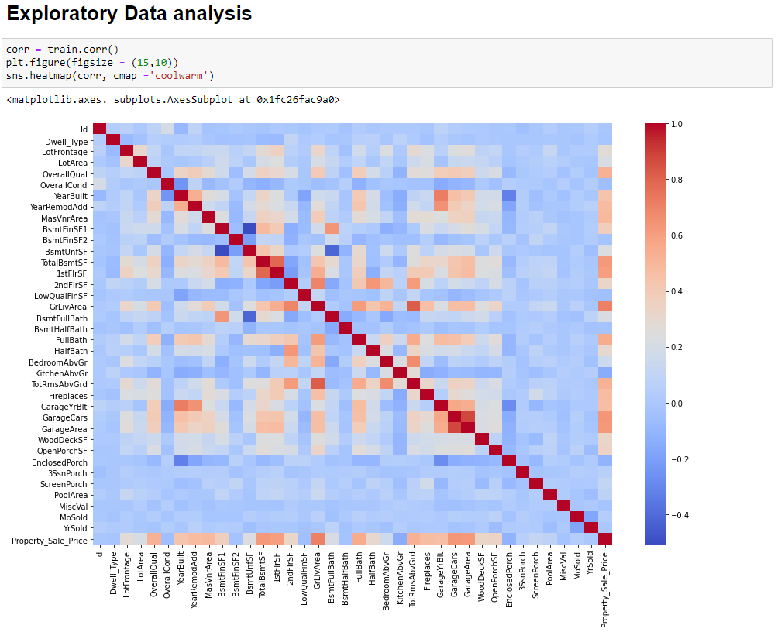
Data Exploration
What is Data exploration?
Data exploration is the initial step in data analysis, where users explore a large data set in an unstructured way to uncover initial patterns, characteristics, and points of interest. This process isn’t meant to reveal every bit of information a dataset holds, but rather to help create a broad picture of important trends and major points to study in greater detail.
train.head(), train.shape, train.columns() can be used to understand the dataset but
Plotting a correlation heatmap helps us to better understanding the relation between the numeric variable.

Slide 6
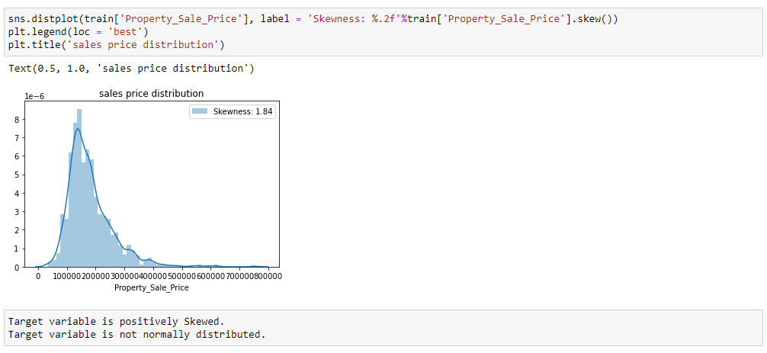
Data Exploration of Dependent Variable
What is skewed data?
A data is called as skewed when curve appears distorted or skewed either to the left or to the right, in a distribution.
By performing distplot function. We understand that the target/dependent variable is positively skewed but not normally distributed.
There are some methods to deal with positively skewed data.
I chose log transformation method. np.log10() function is used to transform the data.

Slide 7
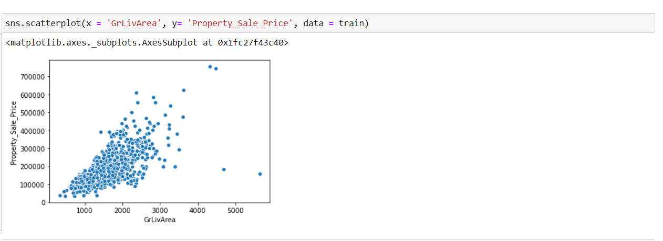
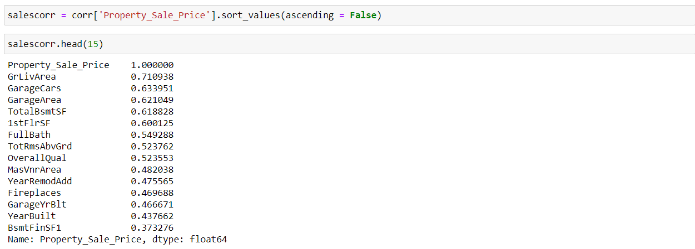
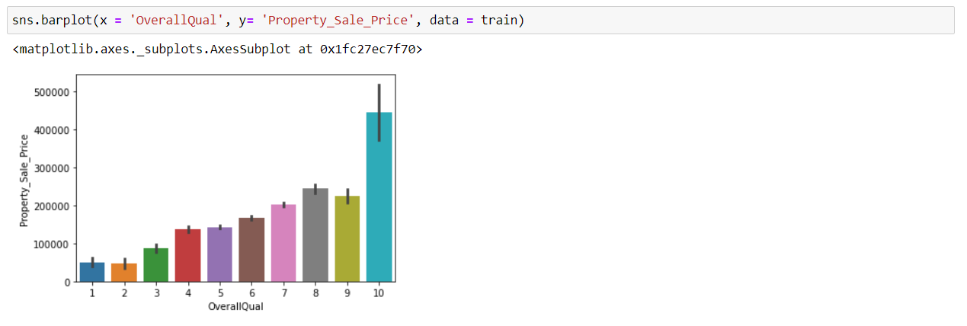
Data Exploration
One thing I learnt from working on PowerBI is that we don’t need to visualize every columns in the dataset.
So here are variables that are highly correlated to target variable.
Plotting these variable for better understanding of the dataset
View more on my notebook

Slide 8
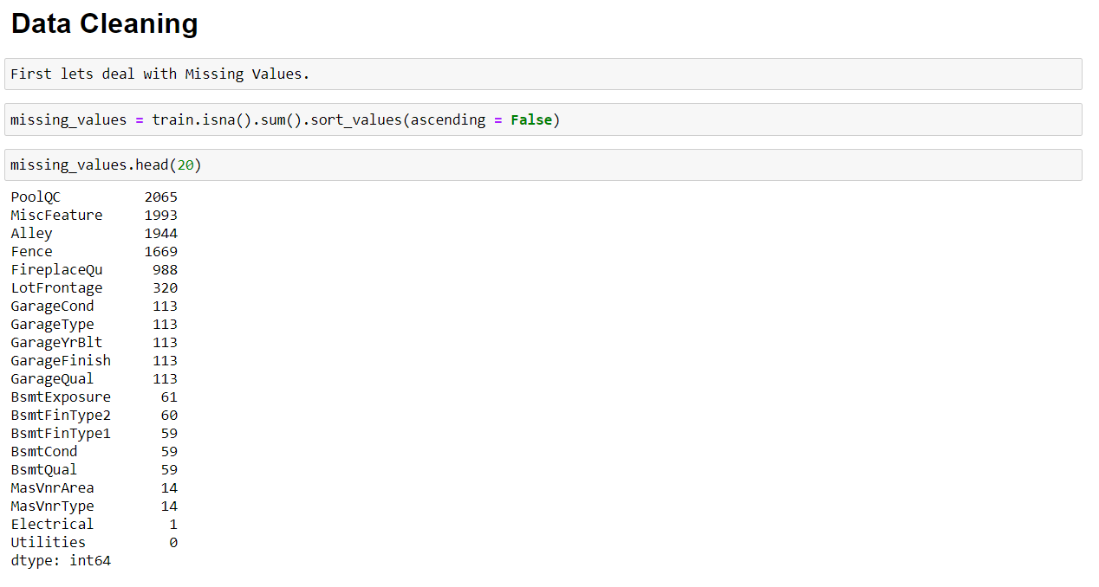
Data Cleaning
What is Data Cleaning?
Data Cleaning means the process of identifying the incorrect, incomplete, inaccurate, irrelevant or missing part of the data and then modifying, replacing or deleting them according to the necessity.
Theoretically, if variable has missing 25% or more data, then it should be dropped from the dataset.
Four variable were dropped, remaining were filled with mode in case of ‘categorical’ variables and median for ‘numeric’ variables

Slide 9
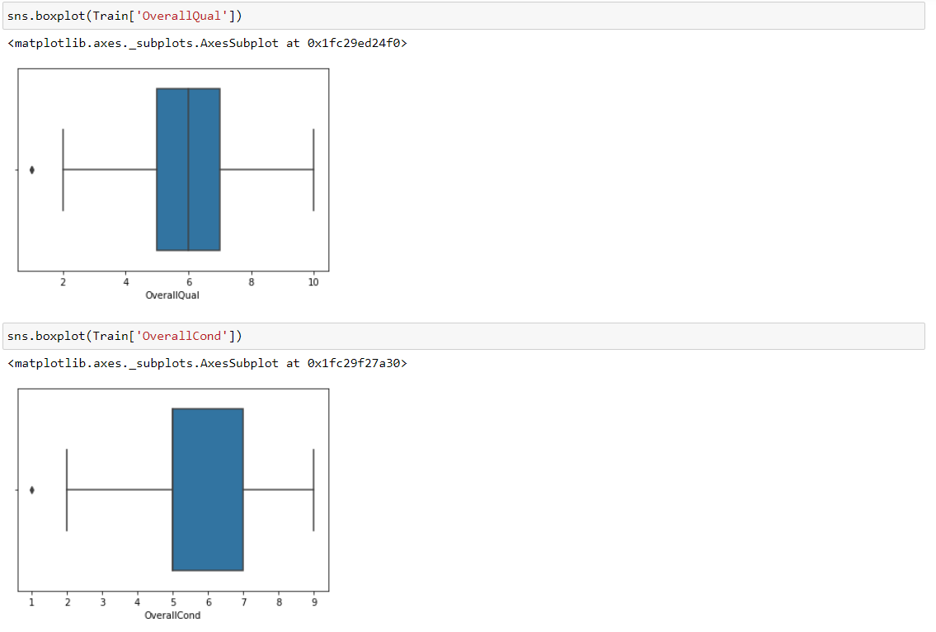
Outlier Detection
What is Outlier?
An outlier is an observation that lies an abnormal distance from other values in a random sample from a population.
Why perform outlier detection?
Identification of potential outliers is important, an outlier may indicate bad data.
My approach for dealing with outliers.
It was simple, I chose not to delete this outliers as we are dealing with less rows and I thought deleting them might not be good for the data. And also as per a article in analytics vidhya, it is suggested that if one doesn’t know how to deal with outliers, it is wise to leave them.

Slide 10
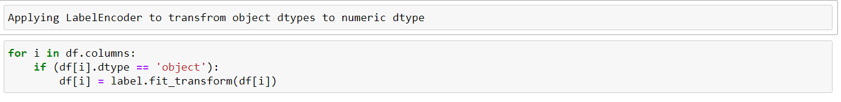
Data Transformation
Why apply Label Encoder?
Label Encoding refers to converting the labels into numeric form so as to convert it into the machine-readable form. Machine learning algorithms can then decide in a better way on how those labels must be operated. It is an important pre-processing step for the structured dataset in supervised learning
I chose to do Label encoder(), we can also use scikit learn one hot encoding or pd.get_dummies() to deal with categorical datatypes

Slide 11
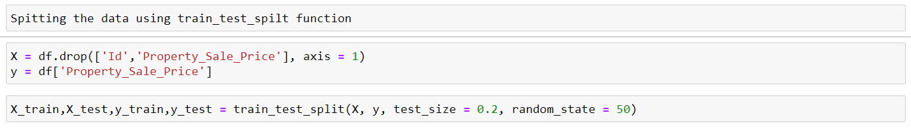
Data Split
Why perform Data Split?
Separating data into training and testing sets is an important part of evaluating data mining models. Typically, when you separate a data set into a training set and testing set, most of the data is used for training, and a smaller portion of the data is used for testing.
Data Split is done using library from scikit learn. That is train_test_split().

Slide 12
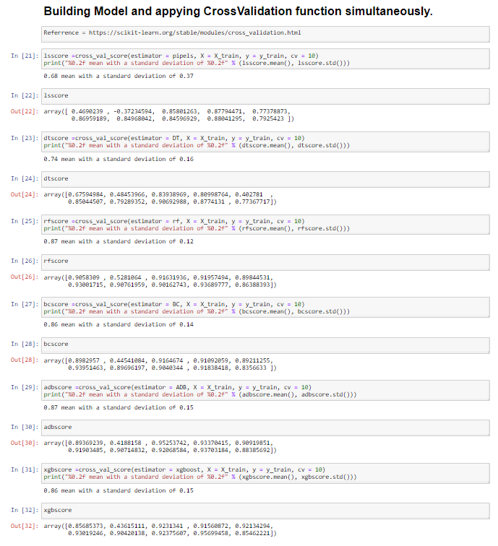
Models Building
Why create multiple models?
Multiples models are created in a project. Once many models are created, then the ones which best fit the training data are compared against the validation data. Then the natural choice is to select the model which most accurately fits the validation data and move on.
So I chose,
Ridge
Decision tree regressor
Random forest regressor
Adaboost regressor
Bagging regressor &
Xgboost regressor

Slide 13
Models Building
Understanding why cross validate is applied?
Cross-validation is a powerful preventative measure against overfitting. We do not need to call the fit method separately while using cross validation, the cross_val_score method fits the data itself while implementing the cross-validation on data
Models with better performance compared to others
Random Forest has highest with 0.86 mean_scores and 0.12 of standard deviation
Adaboost has second best with 086 mean_scores
And 0.15 of standard deviation

Slide 14
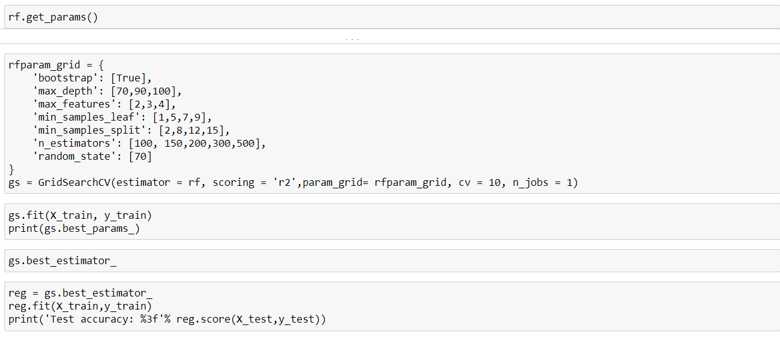
Model Tuning
Understanding why Tuning is done?
Model tuning allows you to customize your models so they generate the most accurate outcomes and give you highly valuable insights into your data. In other words, Tuning is the process of maximizing a model's performance without overfitting or creating too high of a variance.
Selecting Random Forest Regressor to tune the model. Unfortunately notebook kept crashing so it could not be completed.

Slide 15
Thank you
GitHub link :
https://github.com/Meg-Megnath/ML-Capstone-Project
Machine Learning project by :–
Megnath

